Slide 1
Enzyme Kinetics and Catalysis II
3/24/2003

Slide 2
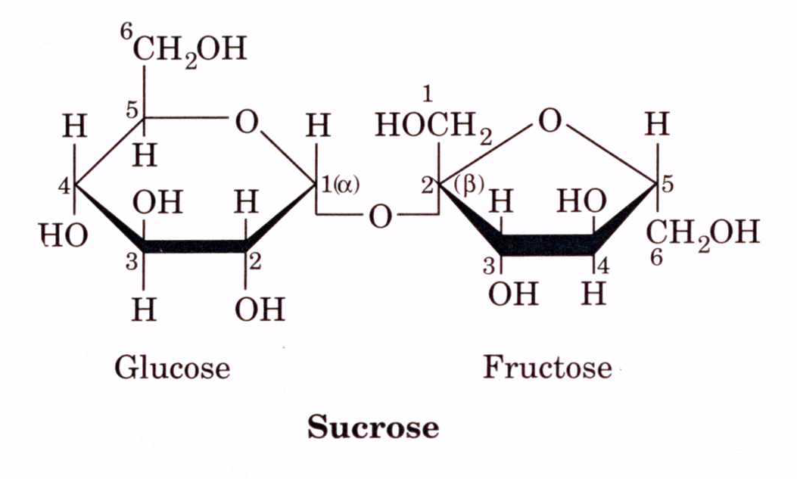
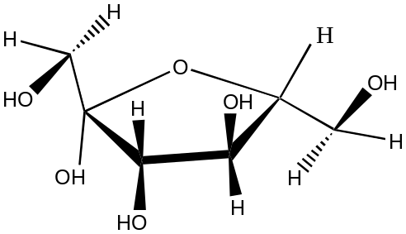
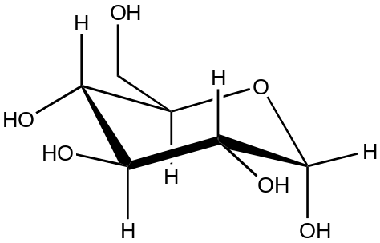
Kinetics of Enzymes
Enzymes follow zero order kinetics when substrate concentrations are high. Zero order means there is no increase in the rate of the reaction when more substrate is added.
Given the following breakdown of sucrose to glucose and fructose
Sucrose + H₂0 Glucose + Fructose

Slide 3
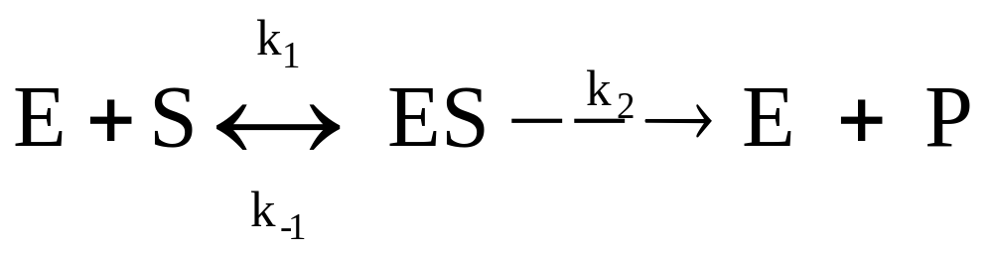
E = Enzyme S = Substrate P = Product
ES = Enzyme-Substrate complex
k₁ rate constant for the forward reaction
k₋₁ = rate constant for the breakdown of the ES to substrate
k₂ = rate constant for the formation of the products

Slide 4
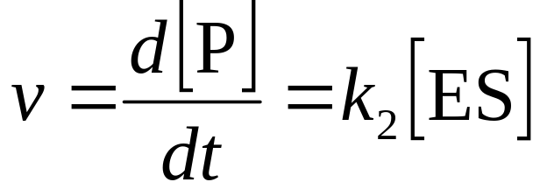
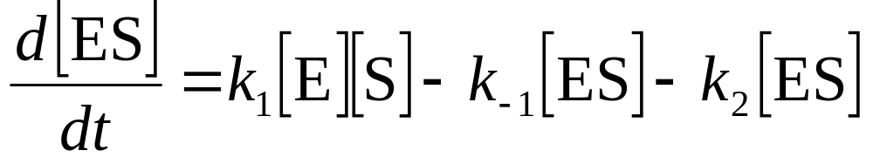
When the substrate concentration becomes large enough to force the equilibrium to form completely all ES the second step in the reaction becomes rate limiting because no more ES can be made and the enzyme-substrate complex is at its maximum value.
[ES] is the difference between the rates of ES formation minus the rates of its disappearance.
1

Slide 5
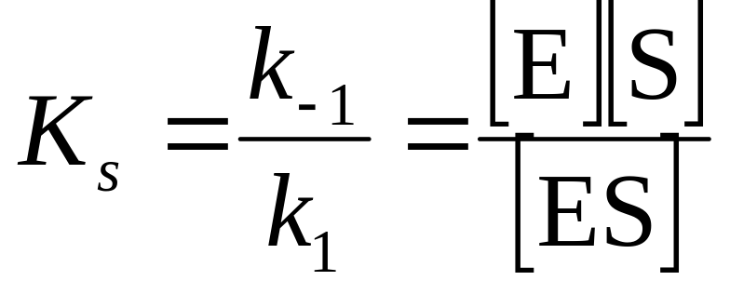
Assumption of equilibrium
k₋₁>>k₂ the formation of product is so much slower than the formation of the ES complex. That we can assume:
K_{s} is the dissociation constant for the ES complex.

Slide 6
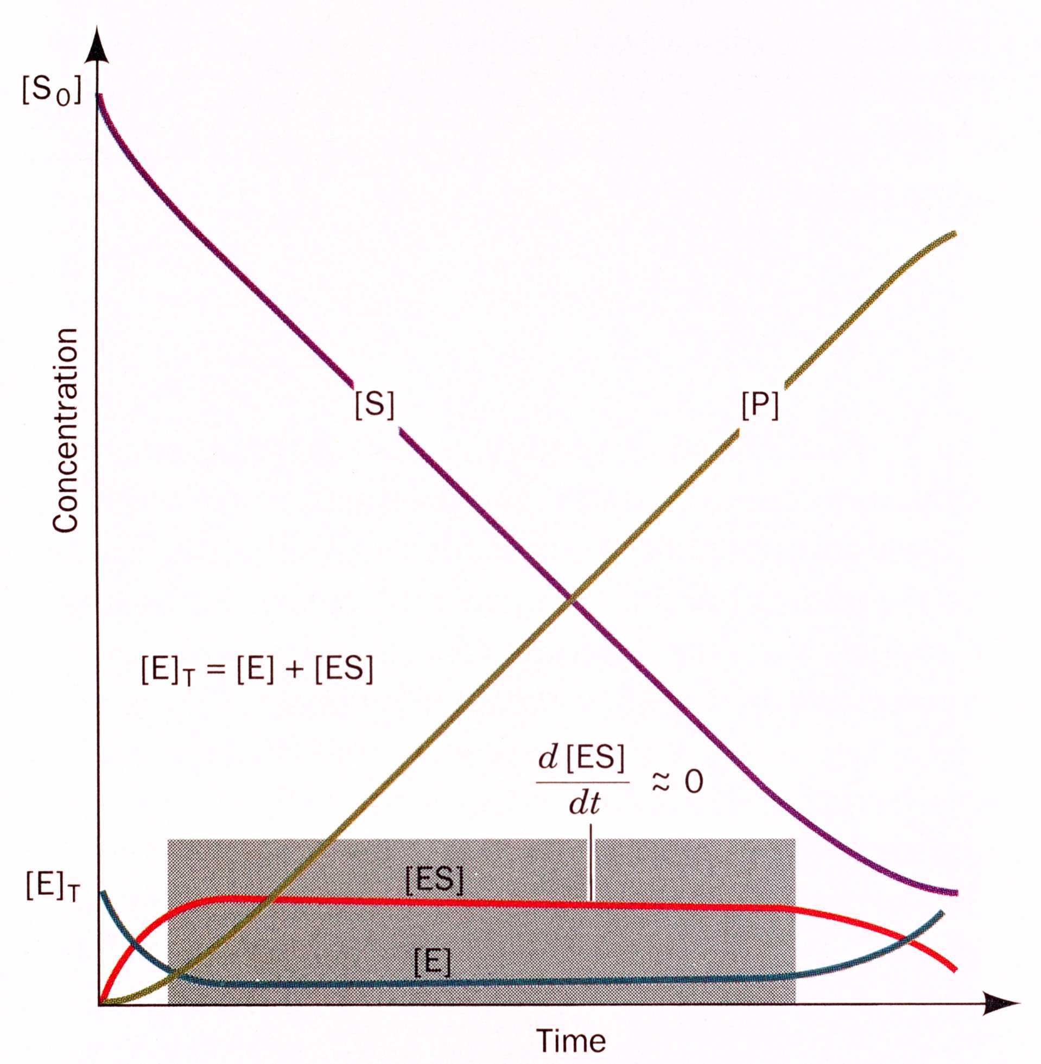
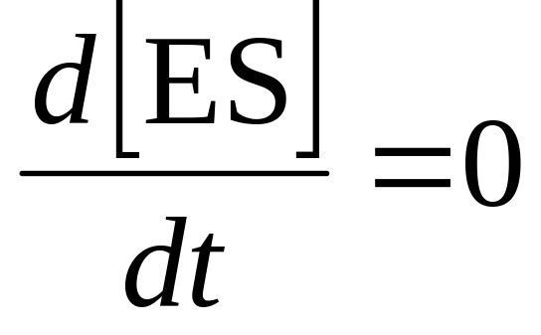
Assumption of steady state
Transient phase where in the course of a reaction the concentration of ES does not change
2

Slide 7
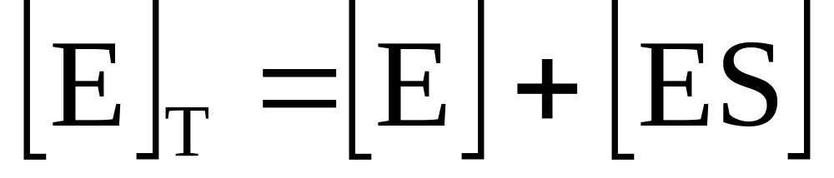
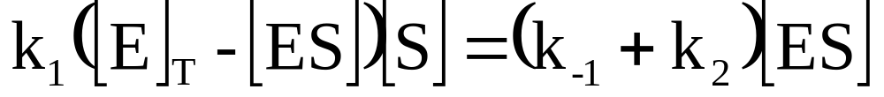
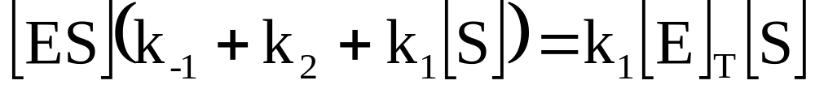
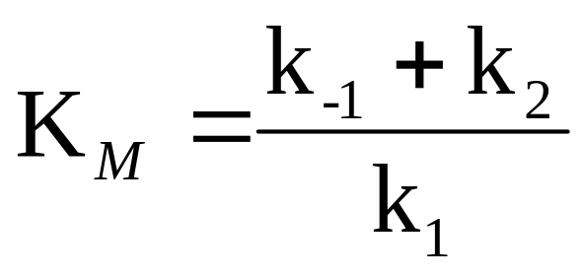
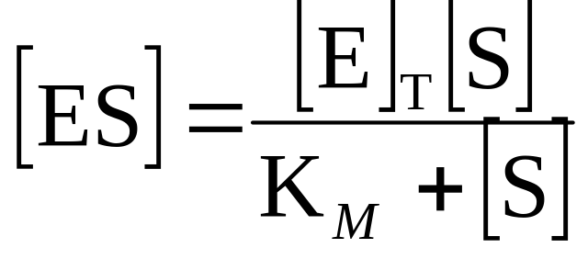
3
Combining 1 + 2 + 3
rearranging
Divide by k₁ and solve for [ES]
Where

Slide 8
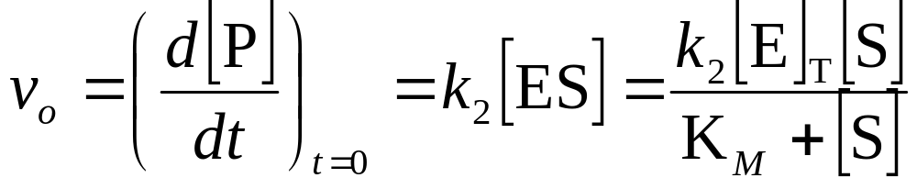
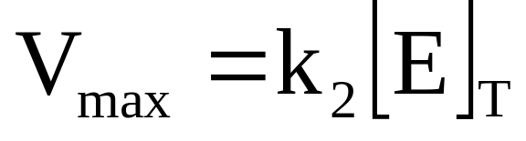
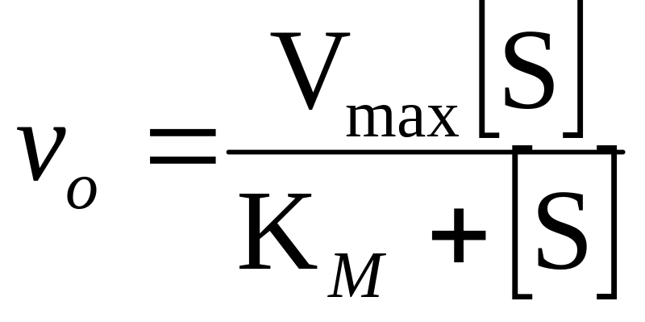
v_{o} is the initial velocity when the reaction is just starting out.
And is the maximum velocity
The Michaelis - Menten equation

Slide 9
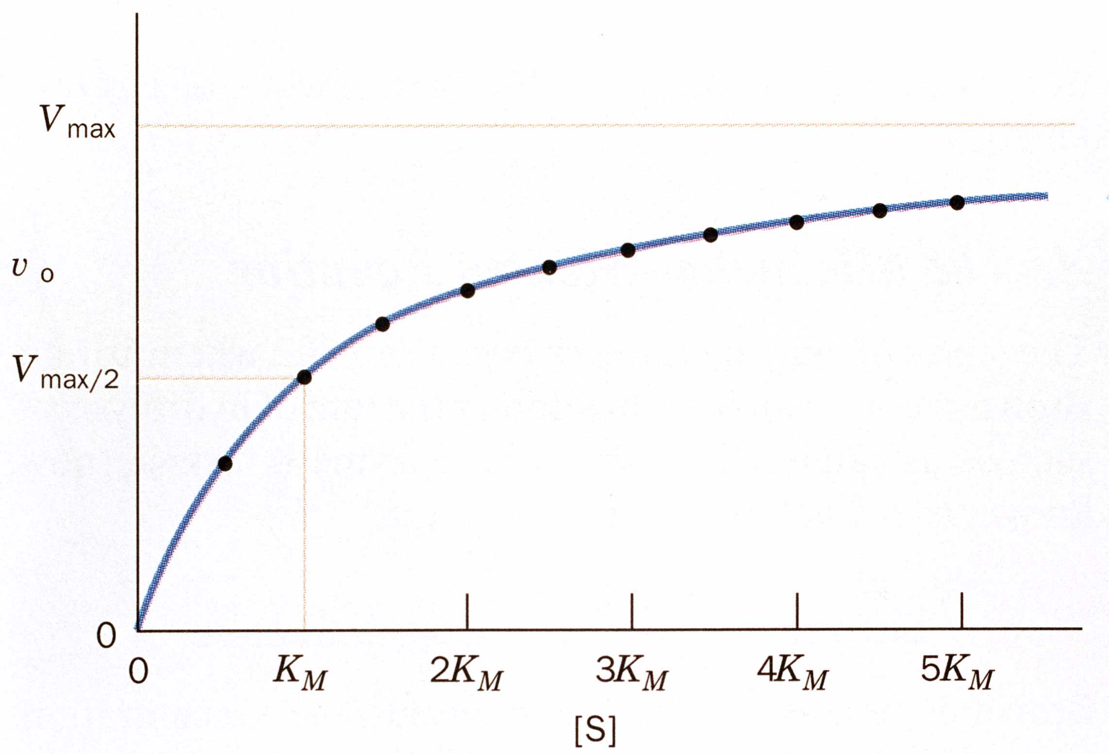
The K_{m} is the substrate concentration where v_{o} equals one-half V_{max}

Slide 10
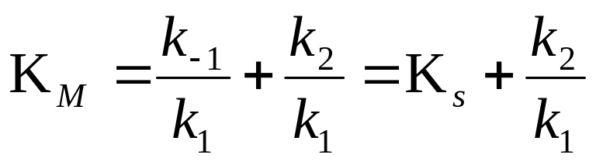
The K_{M} widely varies among different enzymes
The K_{M}
can be expressed as:
As Ks decreases, the affinity for the substrate increases. The K_{M} can be a measure for substrate affinity if k₂<k₋₁

Slide 11
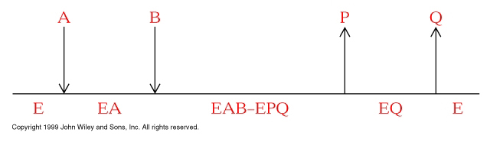
Reaction Mechanisms
A: Sequential Reactions
All substrates must combine with enzyme before reaction can occur

Slide 12
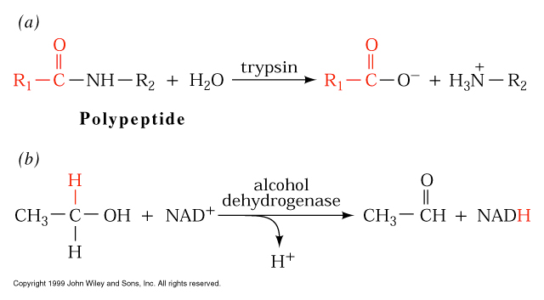
Bisubstrate reactions
Notes:
Single displacement reactions

Slide 13
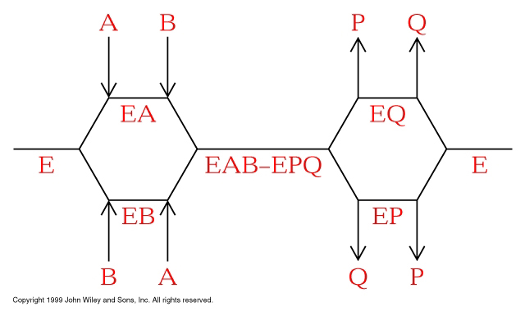
Random Bisubstrate Reactions

Slide 14
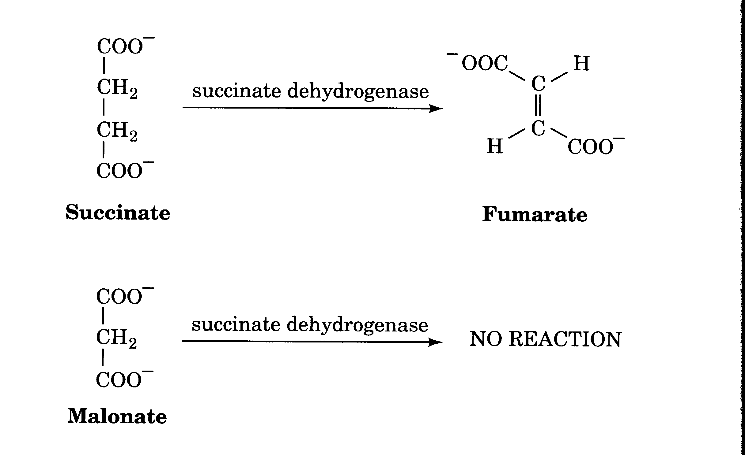
Inhibition kinetics
There are three types of inhibition kinetics competitive,
mixed and uncompetitive.
Competitive- Where the inhibitor competes with the substrate.

Slide 15
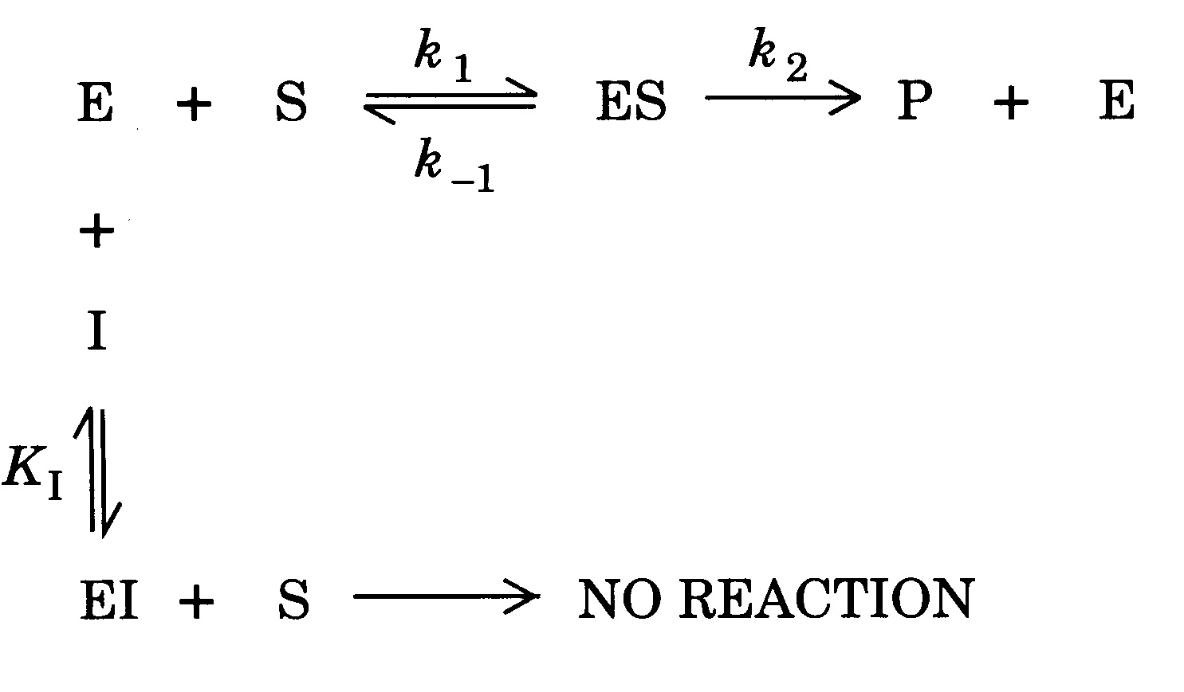
Competitive Inhibition

Slide 16
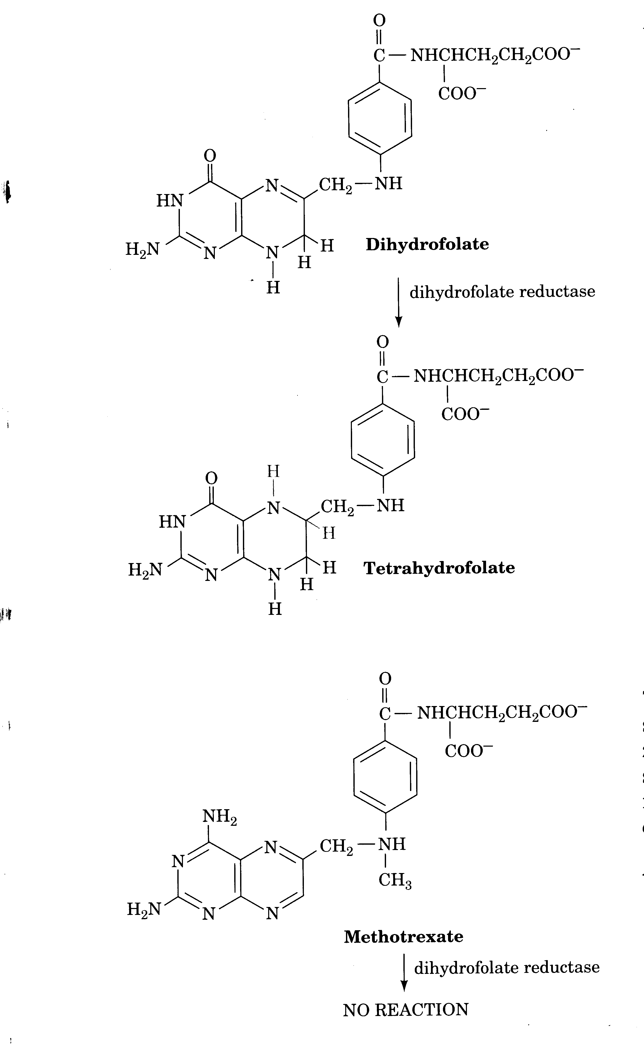
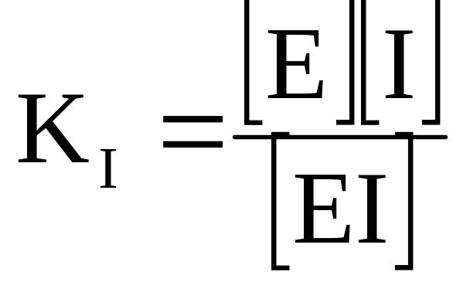
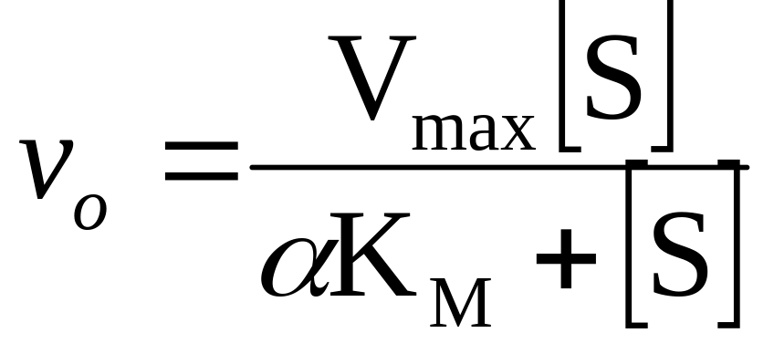
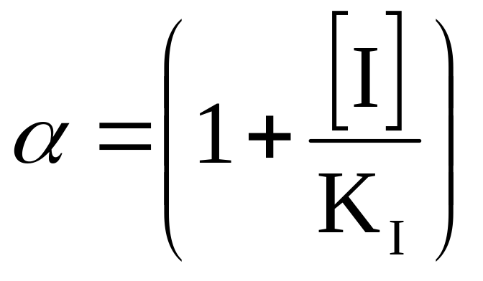

Slide 17
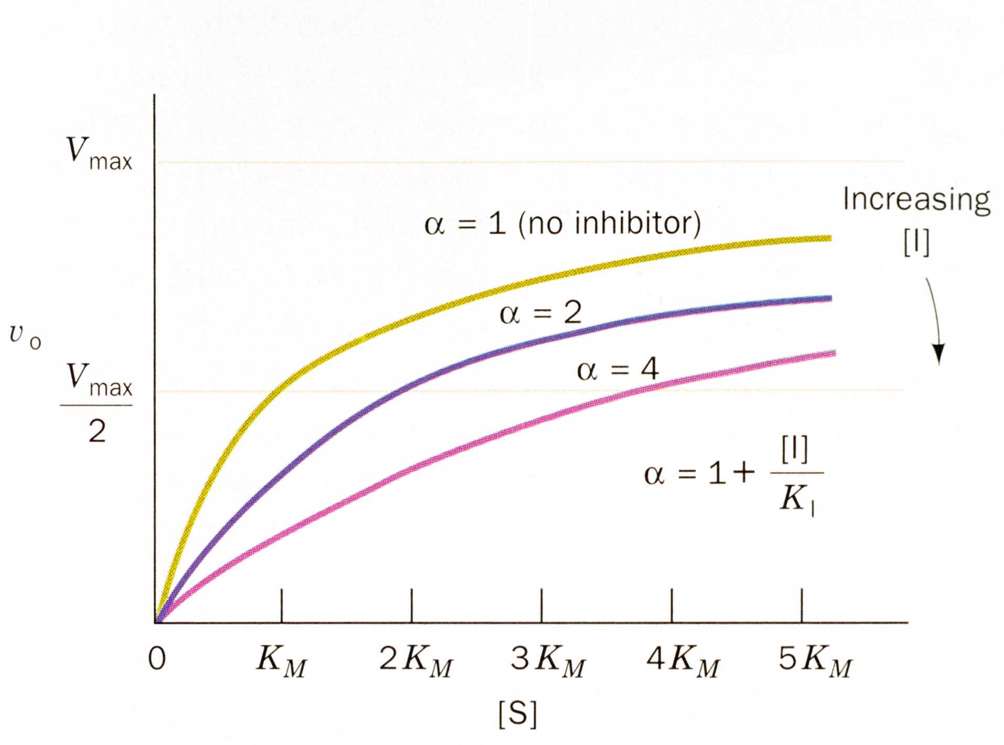

Slide 18
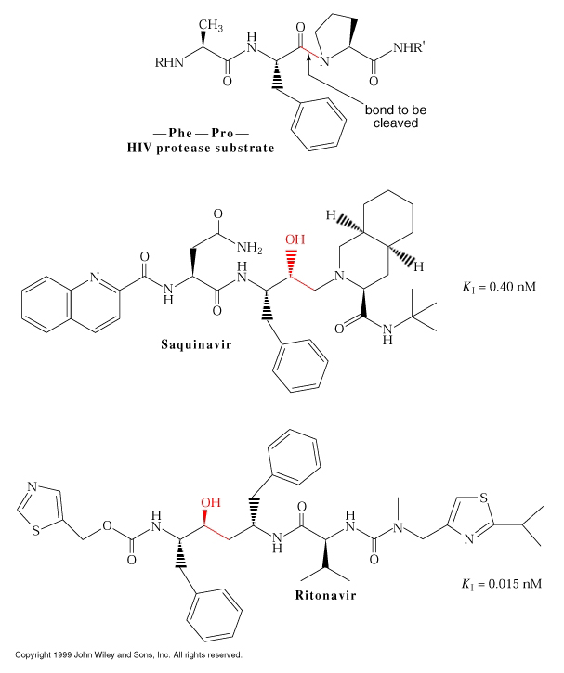
HIV protease inhibitors

Slide 19
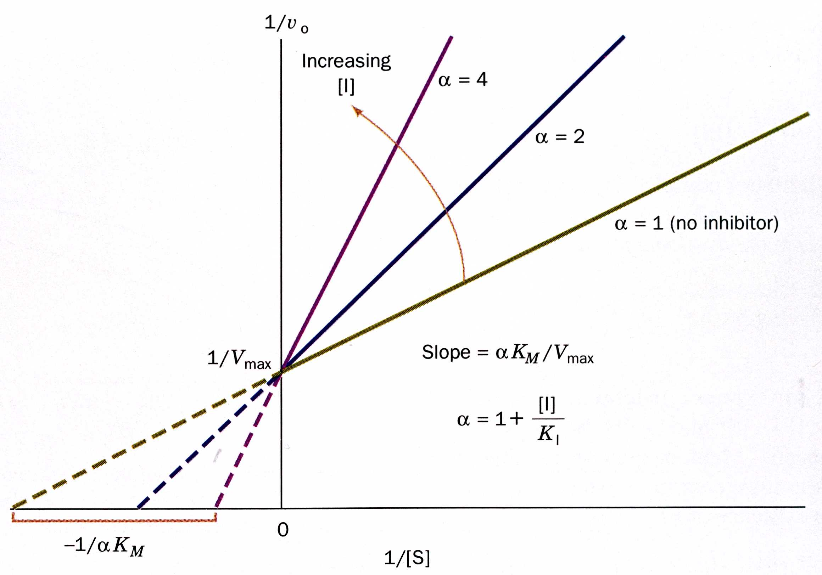
Competitive Inhibition: Lineweaver-Burke Plot

Slide 20
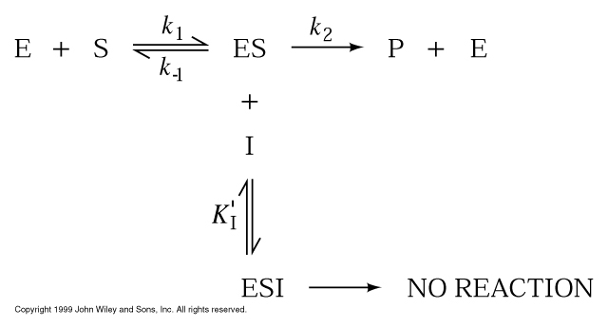
Uncompetitive Inhibition

Slide 21
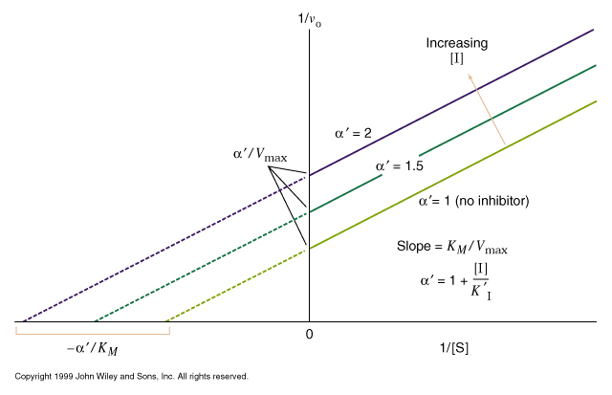
Uncompetitive Inhibition: Lineweaver-Burke Plot

Slide 22
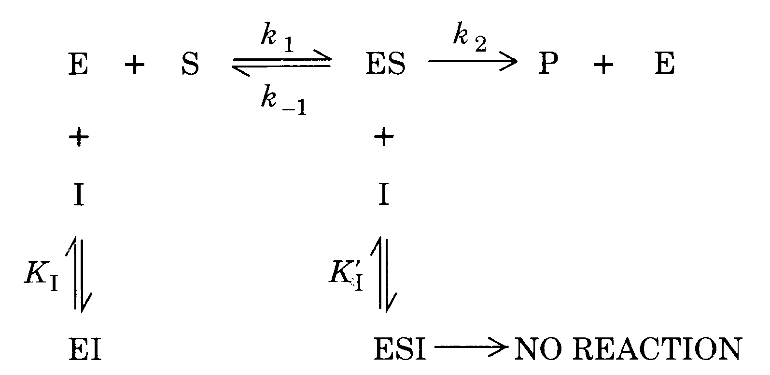
Mixed inhibition

Slide 23
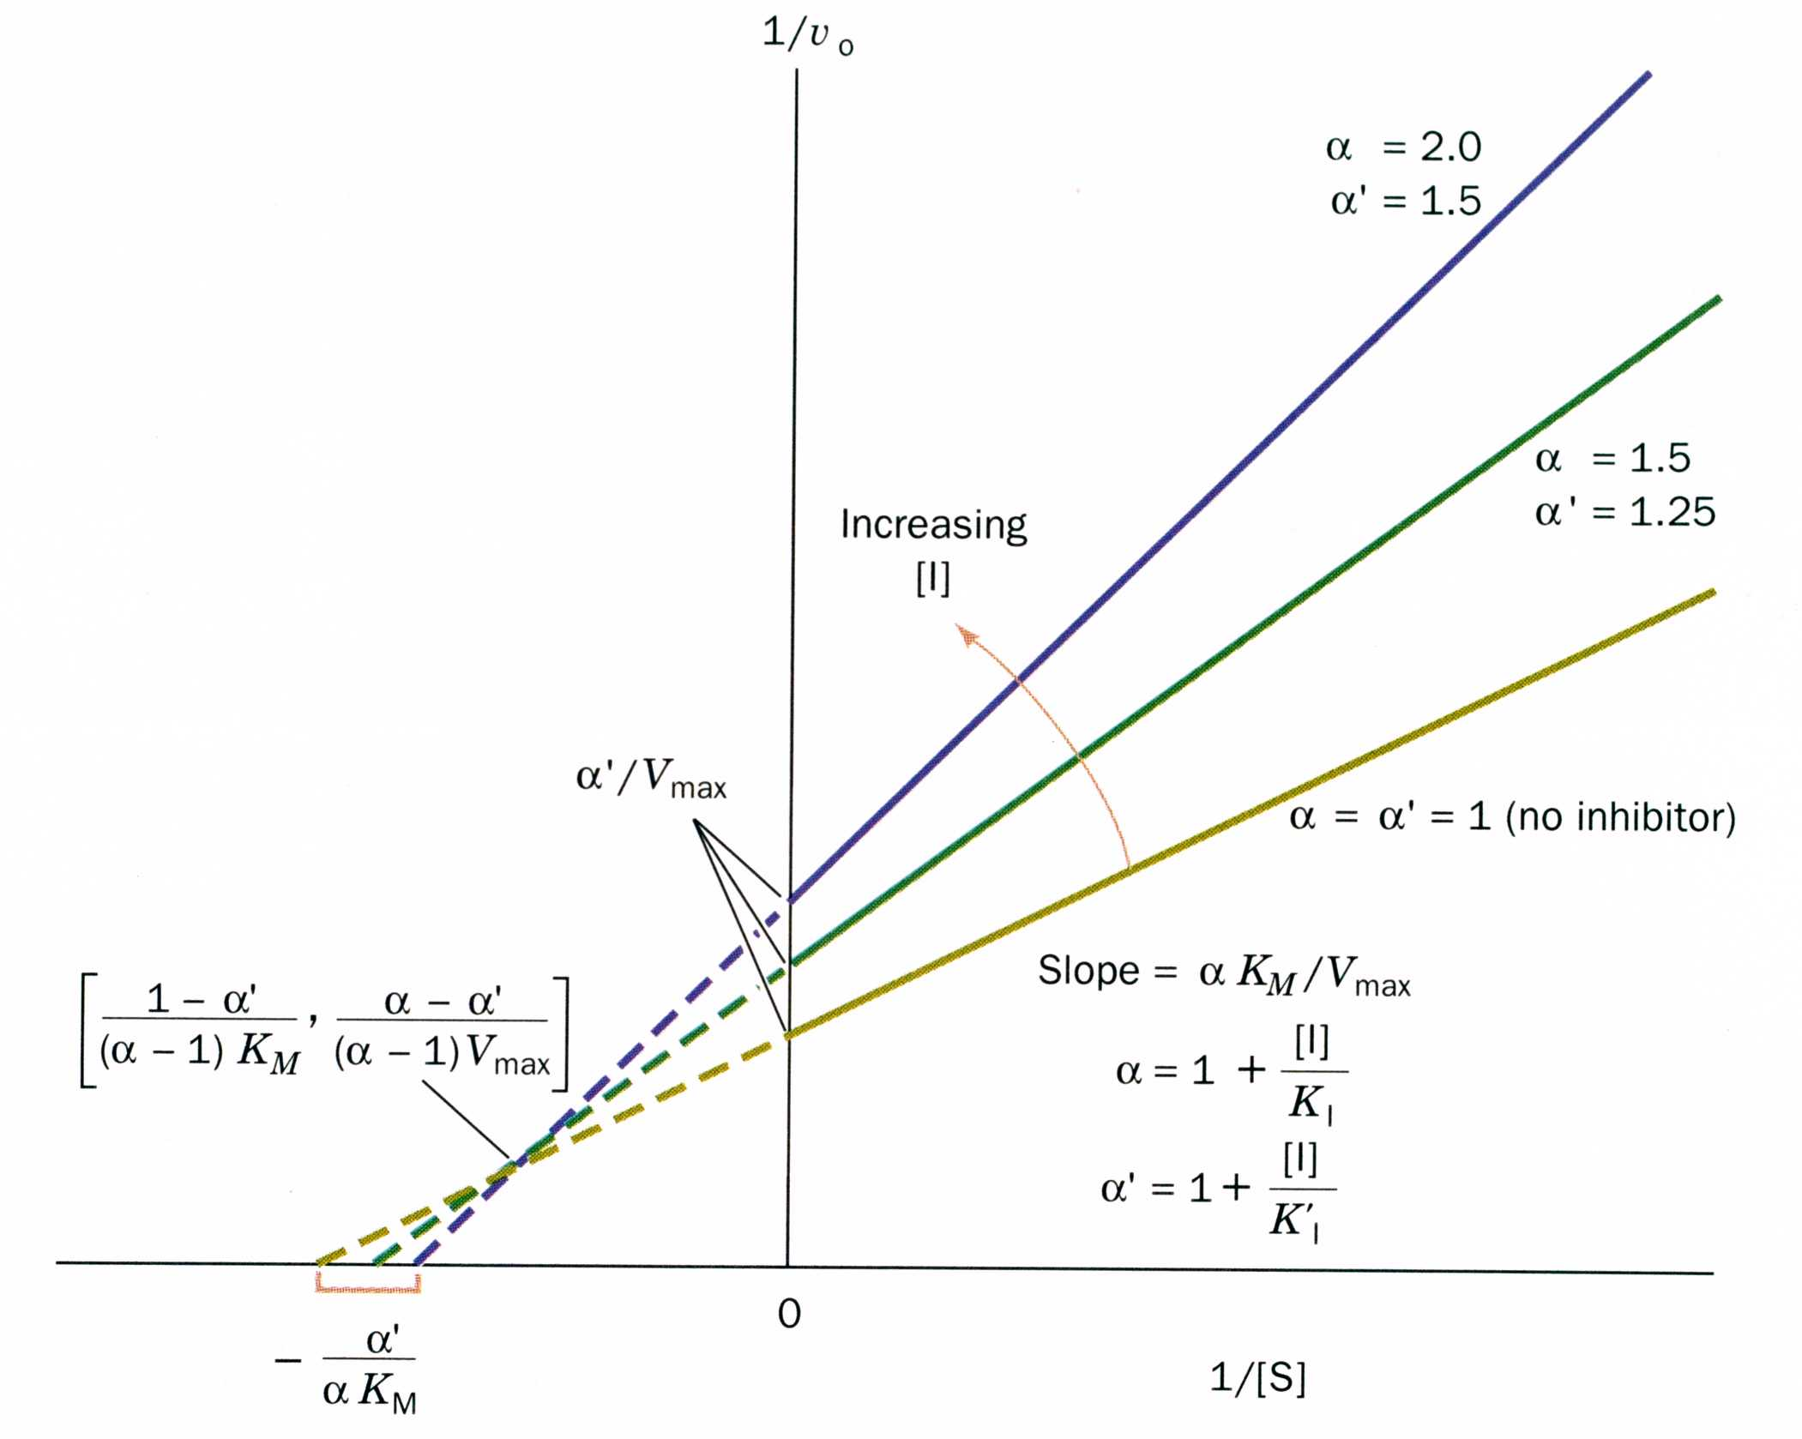

Slide 24
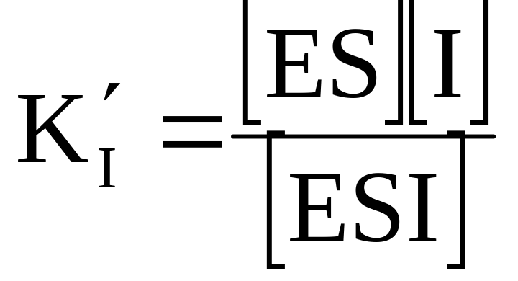
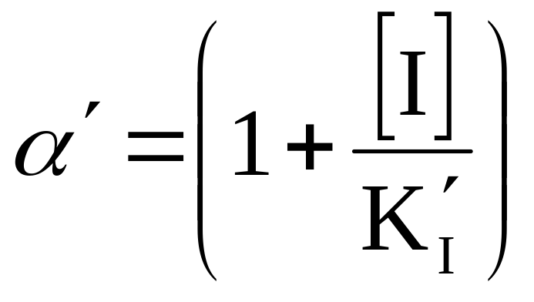
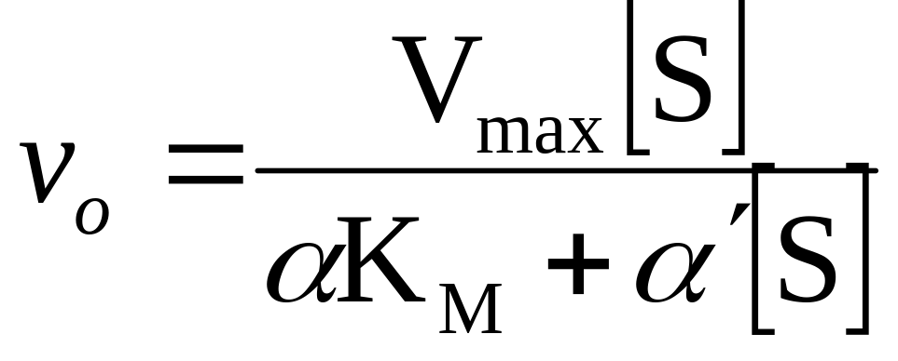
Mixed inhibition is when the inhibitor binds to the enzyme at a location distinct from the substrate binding site. The binding of the inhibitor will either alter the K_{M} or V_{max} or both.

Slide 25
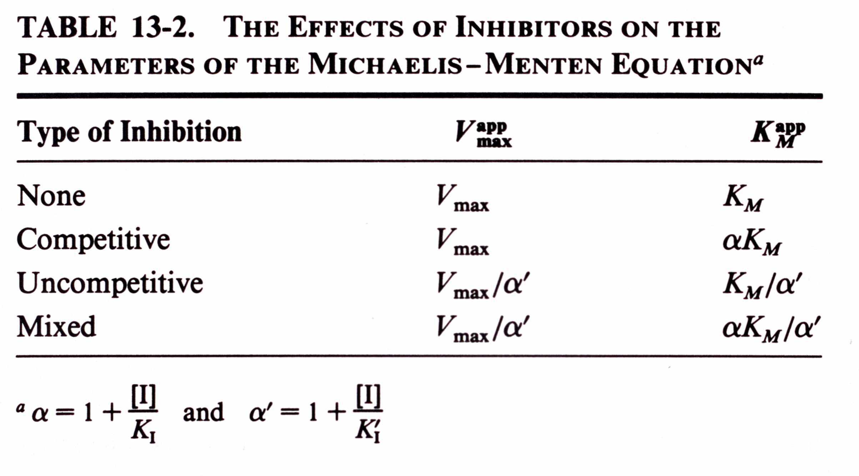

Slide 26
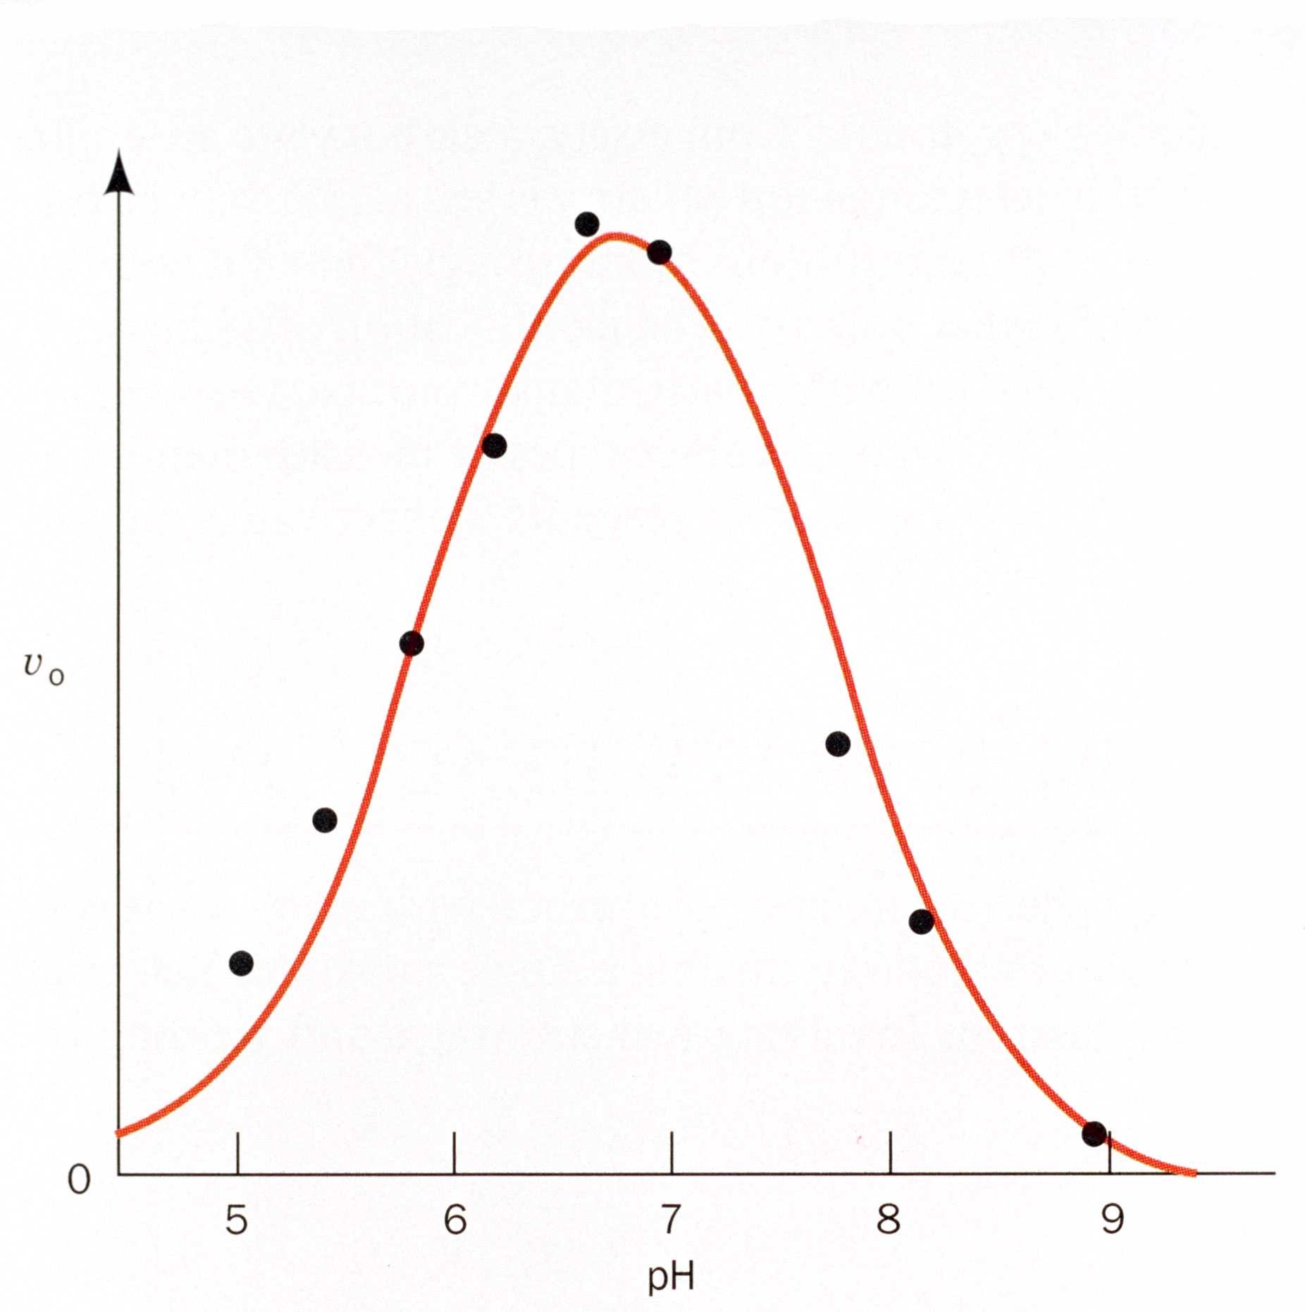
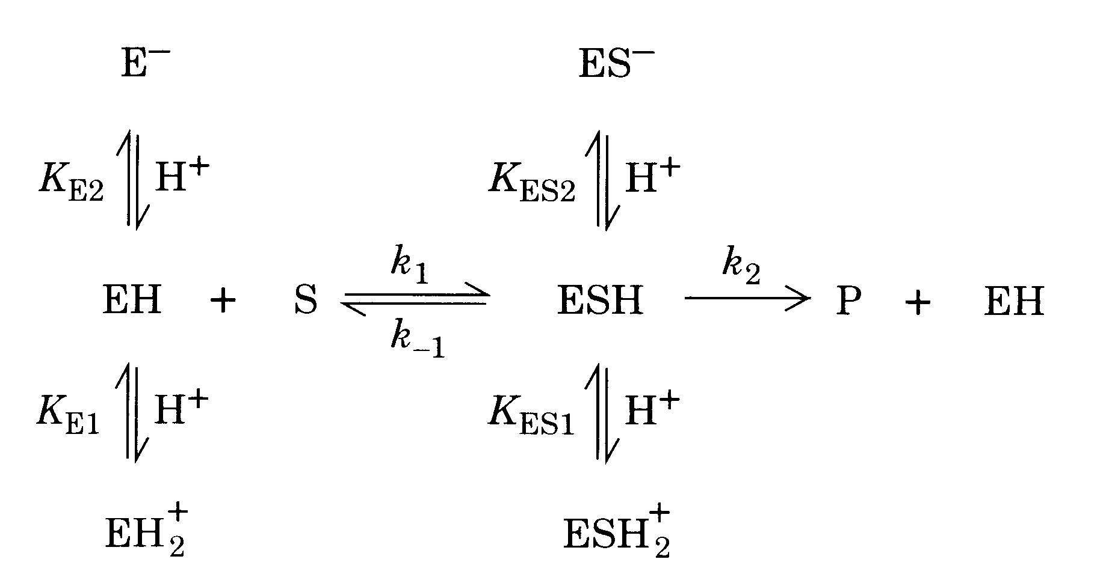
The effect of pH on kinetic parameters

Slide 27
